Slide 1
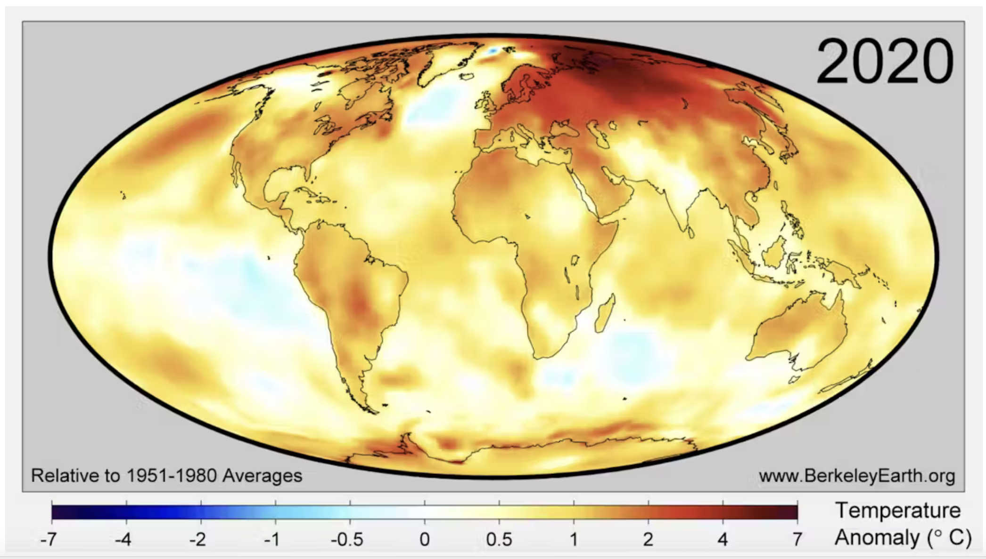
The “Albedo” video (Climate Emergency: Feedback Loops) referred to the “New Arctic”

Slide 2
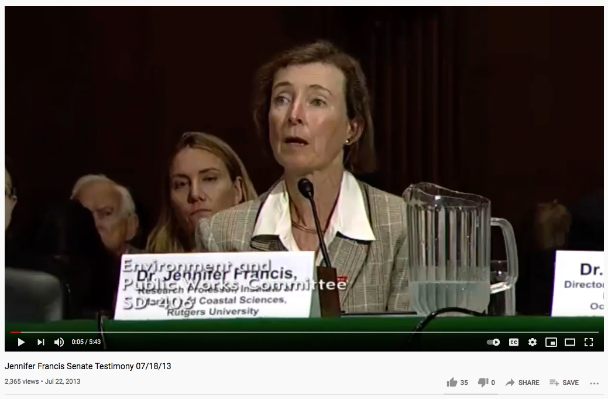
Repercussions of Arctic warming you may not have imagined (Francis and Vavrus, 2013)
https://www.youtube.com/watch?v=8eyNm2QcOw8&feature=youtu.be

Slide 3


Slide 4
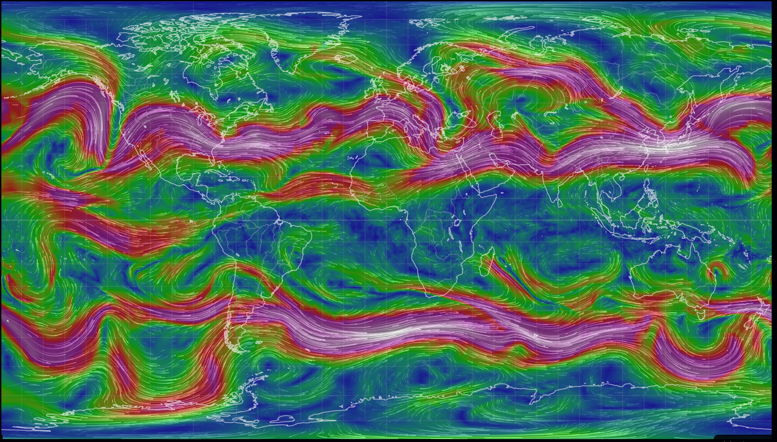
Jet stream forms a meandering boundary between cold Polar air and warmer mid-latitude air
Cold Arctic air
Warm mid-latitude air
Cold Antarctic air

Slide 5
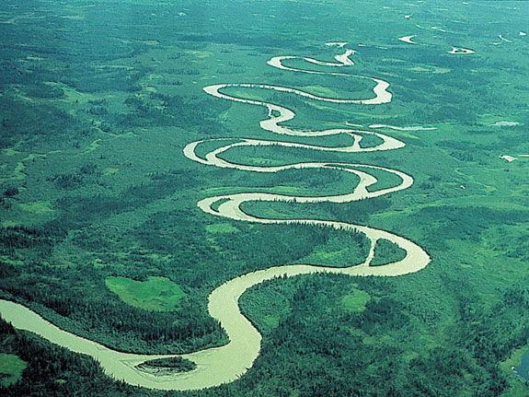
But meandering happens more when the terrain is flat

Slide 6
Warmer Arctic -> less temperature difference between Arctic and mid-latitude -> jet is wavier and slower with larger perturbations
Cold Arctic air
Warm mid-latitude air
Cold Antarctic air

Slide 7
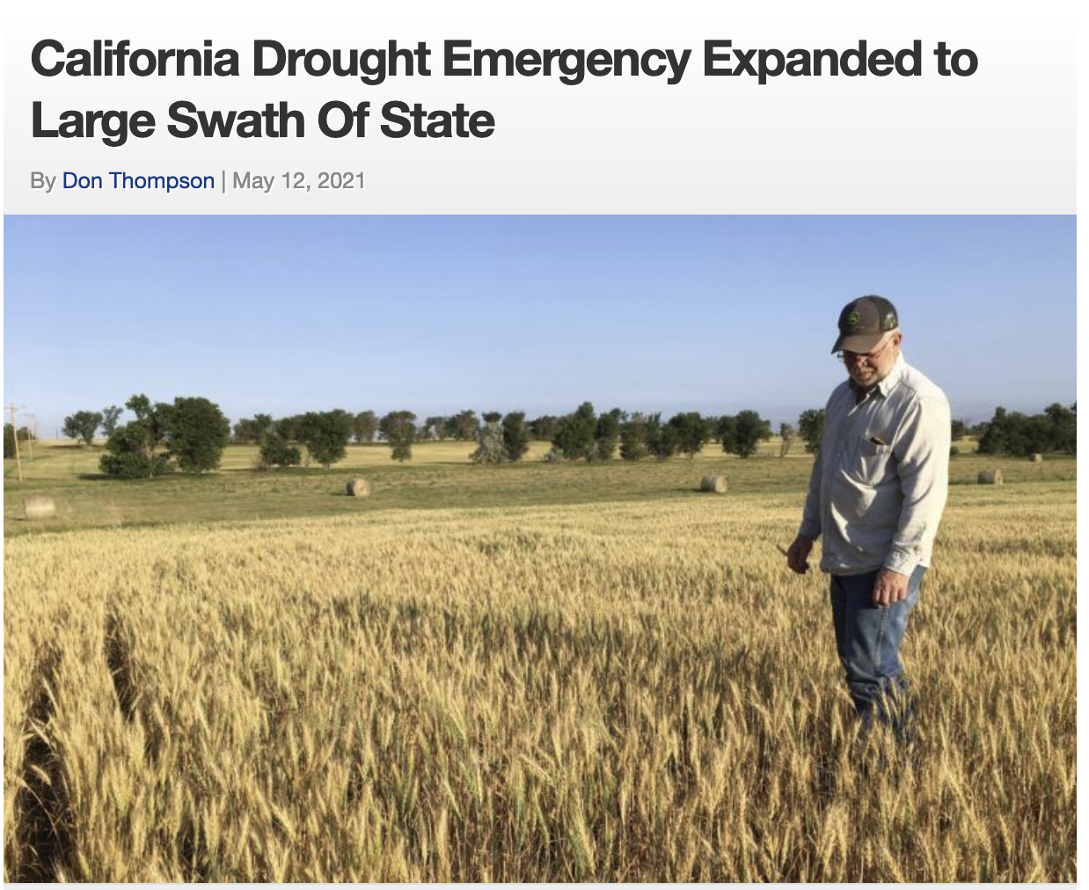
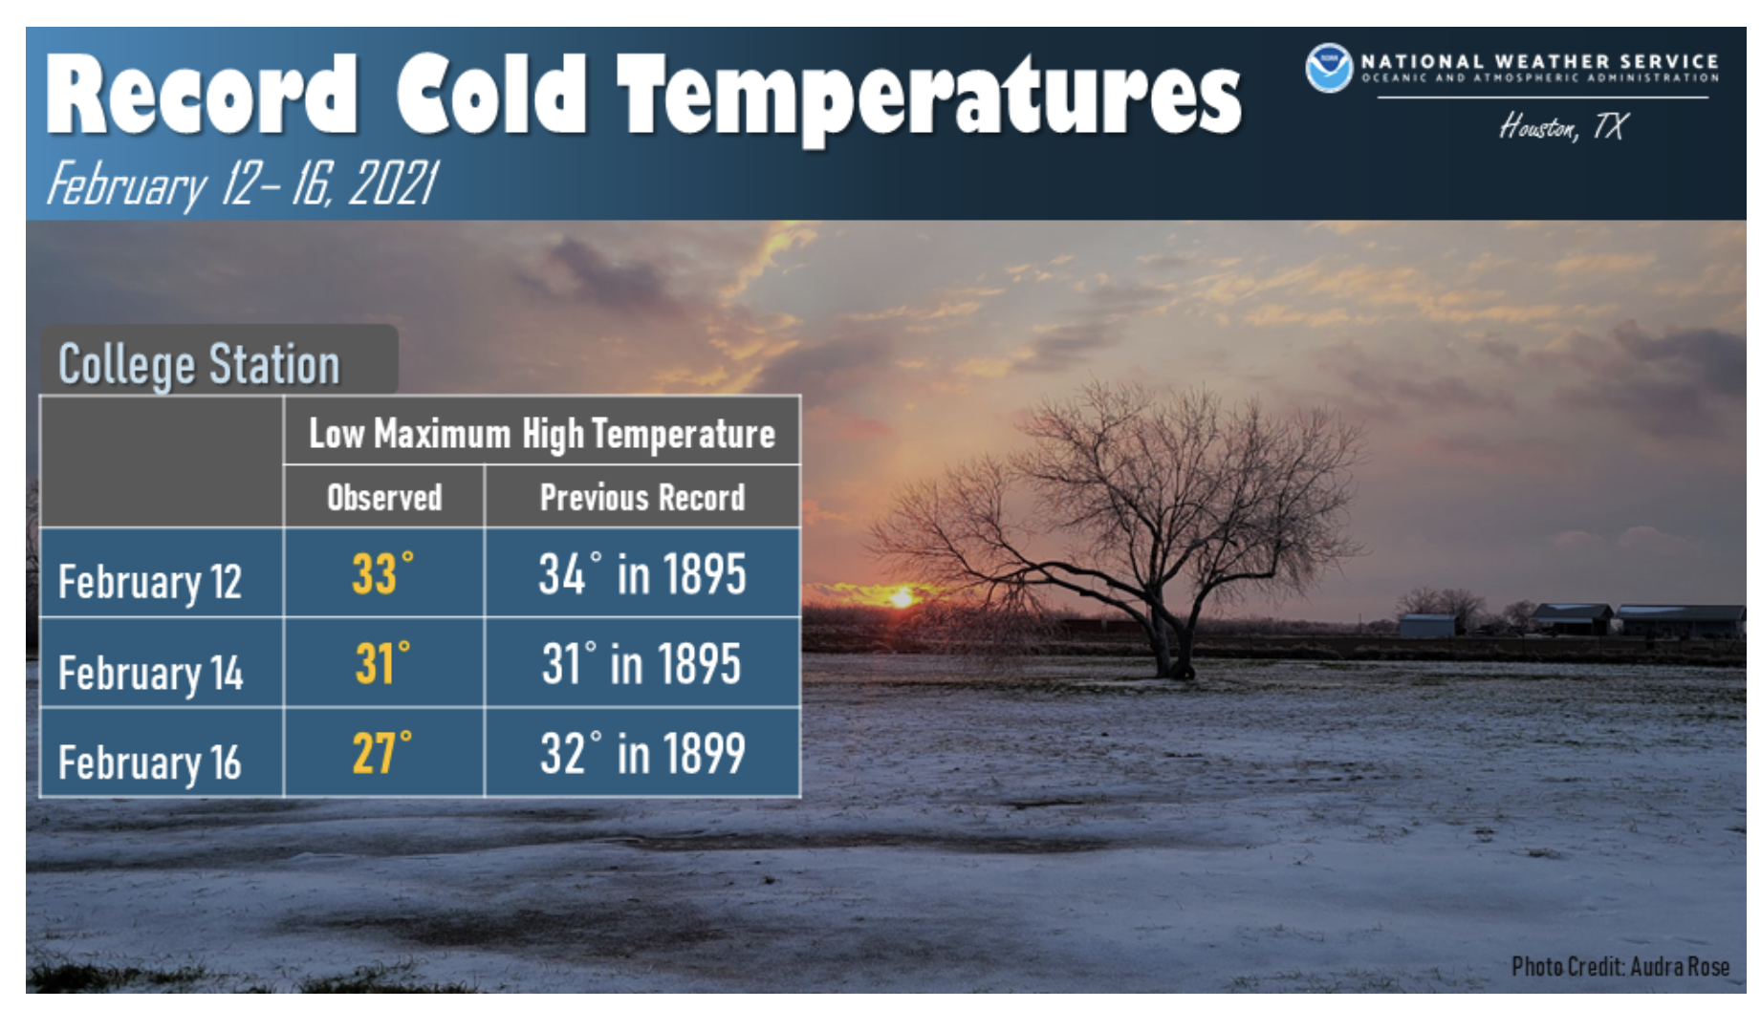

Warmer Arctic -> less temperature difference between Arctic and mid-latitude -> jet is wavier and slower with larger perturbations -> prolonged periods of drought and cold

